Slide 1
Truly Byzantine: Optimal Attacks in Distributed Machine Learning
Haowen Liu
Supervised by Youssef Allouah, Pr. Rachid Guerraoui
DCL, EPFL
Notes:
Hello everyone, today I'm excited to talk about our work on 'Optimal Attacks in Distributed Machine Learning'.

Slide 2
Overview
Omniscient Attackers
Nonlinear Programming Attacks
Mean Estimation, Logistic Regression, CNNs
What if the Adversary is Truly Byzantine?
Notes:
We'll dive into the critical question: "What if the Adversary is Truly Byzantine?" in distributed machine learning.
Firstly, we discuss "Omniscient Attackers". This means the worst-case scenario where adversary possessing absolute knowledge of our distributed learning system. We question - what if they utilized this complete knowledge to cause the maximum possible disruption?
Next, we'll tackle "Nonlinear Programming Attacks". Here we approach the Byzantine attack problem as an optimization problem, which can be tackled using nonlinear programming techniques. By doing so, we present a principled way to design truly Byzantine attack strategies.
Lastly, we have conducted experiments across different tasks like Mean Estimation, Logistic Regression, and Convolutional Neural Networks. We use them to evaluate the efficacy of our proposed attack strategies compared to existing ones.
Moreover, these findings also shed light on the limitations of current defense mechanisms, and provide valuable insights for future improvements.
Stay with us as we explore these concepts in depth.

Slide 3
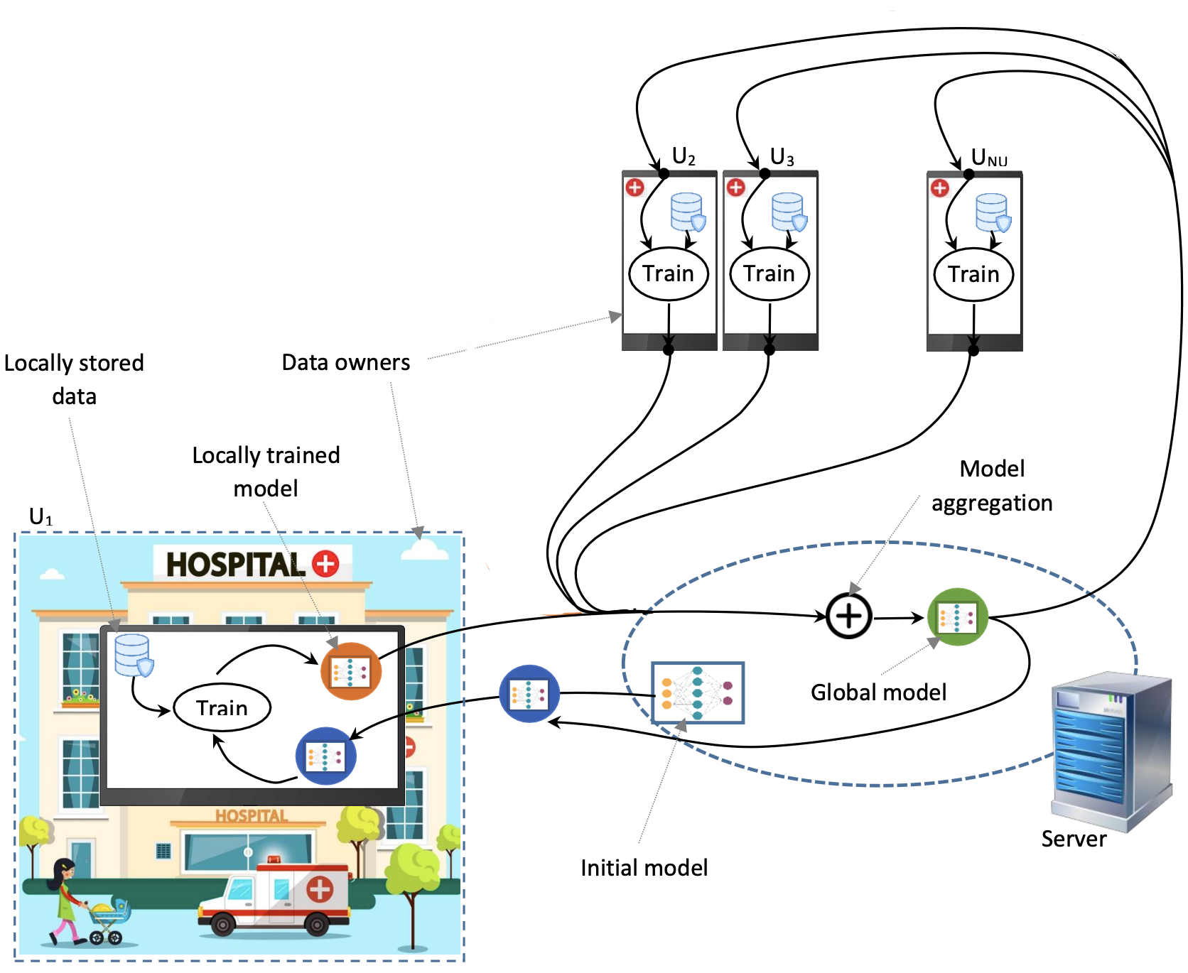
Introduction
- Distributed Machine Learning (ML)
- Benefits: Training large models, Preserving data privacy
- Widely accepted in academia and industry
[1] A. Gouissem, K. Abualsaud, E. Yaacoub, T. Khattab and M. Guizani, "Federated Learning Stability Under Byzantine Attacks," 2022 IEEE Wireless Communications and Networking Conference (WCNC), Austin, TX, USA, 2022, pp. 572-577, doi: 10.1109/WCNC51071.2022.9771594.
Notes:
To begin, let's clarify what we're dealing with.
In this era of large-scale data, distributed machine learning has become our go-to strategy.
It helps us manage huge models, maintain data privacy, and is widely accepted in both academia and industry.

Slide 4
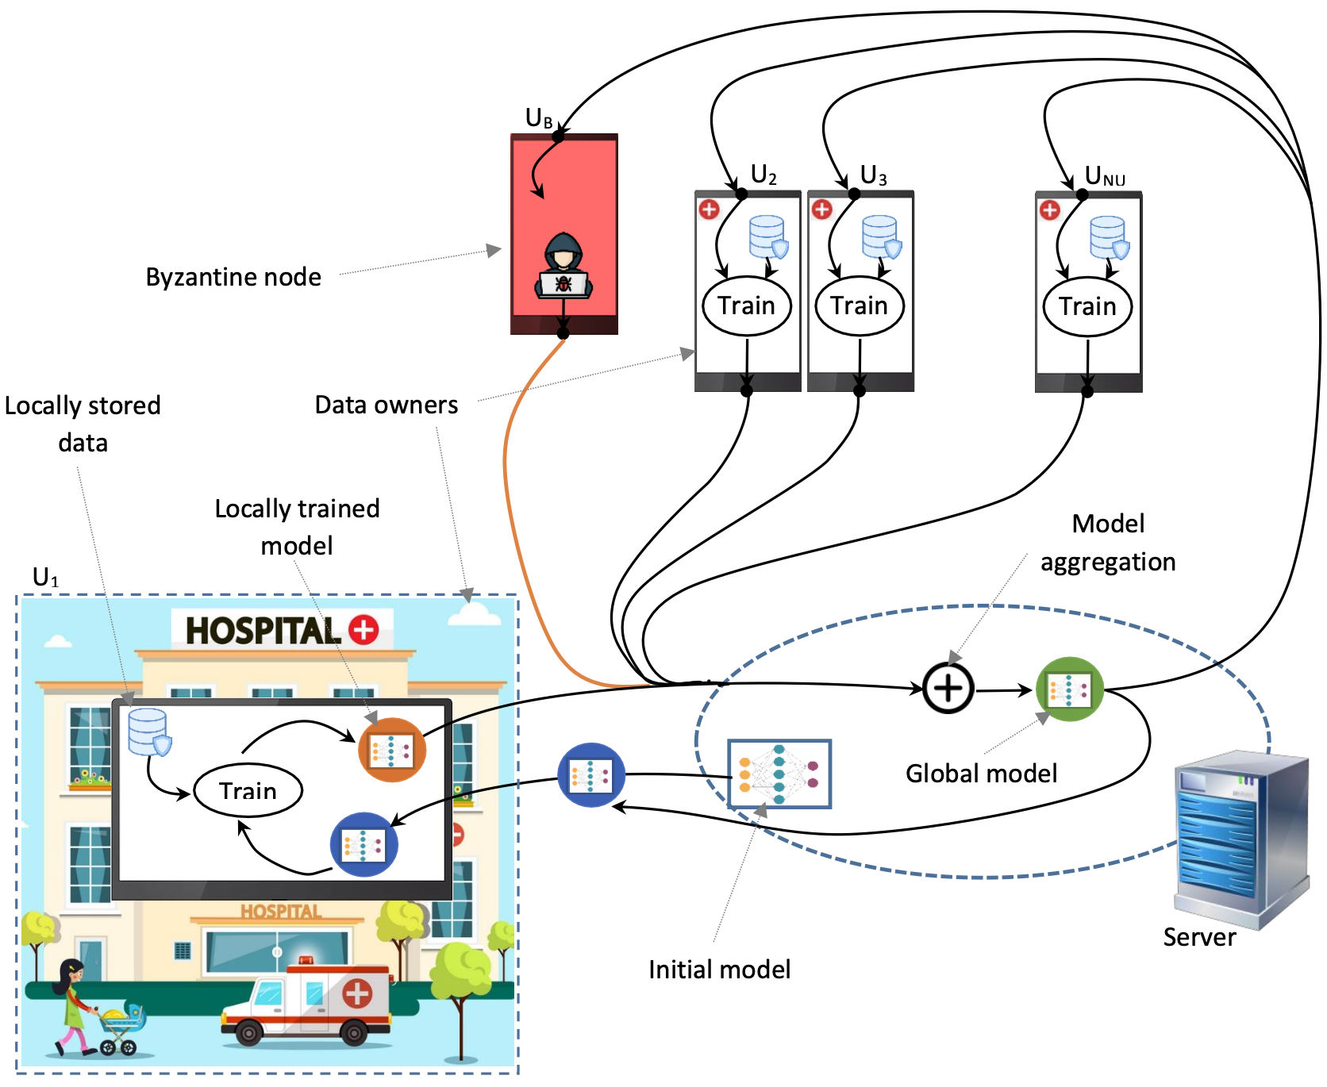
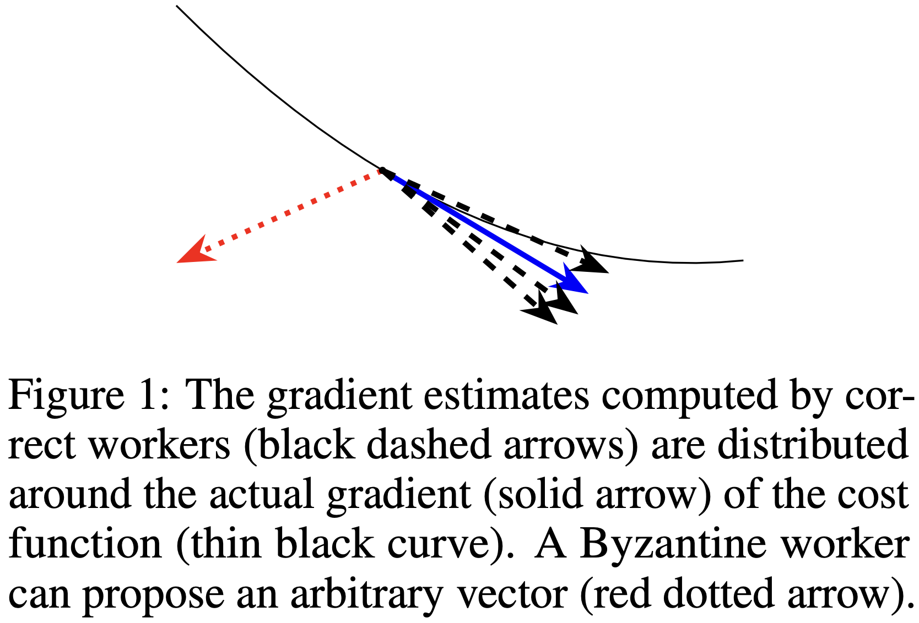
Introduction
- Byzantine Resilience
- Requirement for distributed optimization algorithms
- Protection against malicious machines, or Byzantine workers
[2] Peva Blanchard, El Mahdi El Mhamdi, Rachid Guerraoui, and Julien Stainer. 2017. Machine learning with adversaries: byzantine tolerant gradient descent. In Proceedings of the 31st International Conference on Neural Information Processing Systems (NIPS'17). Curran Associates Inc., Red Hook, NY, USA, 118–128.
[3] A. Gouissem, K. Abualsaud, E. Yaacoub, T. Khattab and M. Guizani, "Federated Learning Stability Under Byzantine Attacks," 2022 IEEE Wireless Communications and Networking Conference (WCNC), Austin, TX, USA, 2022, pp. 572-577, doi: 10.1109/WCNC51071.2022.9771594.
Notes:
But there's a twist: Byzantine workers.
They are malicious entities that share incorrect information, disrupting the learning procedure.
They pose a serious threat to our learning system's integrity.

Slide 5
Are distributed learning models still safe?
Homogeneity
Label Flipping
Krum
Sign Flipping
CWMed
Distributed
Momentum
Model
MinMax/MinSum
GM
NNM
Bucketing
CWTM
Mimic
C-Clip
D-SHB
ALIE
…
IPM
Heterogeneity
Notes:
To tackle Byzantine gradients, several defense mechanisms have been proposed,
including those pre-aggregation methods, NNM and Bucketing, and robust aggregation algorithms like Krum and coordinate-wise median.
And recent research found that distributed momentum has very good guarantee to defend against Byzantine workers, that is, applying momentum at the client side and sending the momentum-weighted average of the past gradients to the server for aggregation and updating.
However, we continue asking, are distributed learning models still safe under the protection of so many defense methods?
How about in homogeneity setting and heterogeneity setting?
Is there an attack that is truly Byzantine to be a benchmark of those defense methods?

Slide 6
Problem Statement
Notes:
The issue we're discussing here is simple yet profound.

Slide 7
Problem Statement
- What is a bad attack?
- Lacks theoretical foundations
- May not represent worst-case behavior of Byzantine worker
- e.g. does not use full information, computational unboundedness, …
- What is a truly Byzantine attacker?
Notes:
First let’s talk about “what is a bad attack?”
Label Flipping, Sign Flipping, those are attacks that use heuristics and lacks theoretical foundations.
MinMax and MinSum, they use a principled way to design attacks, so they have some theoretical foundations, but they do not use the full information of distributed learning system, so they may not represent the worst-case behavior of Byzantine workers. They are far from truly Byzantine.
So what’s a truly Byzantine attacker?

Slide 8

Problem Statement
- Graybox: Limited Attacker vs. Whitebox: Omniscient Attacker
[4] Limited vs. Omniscient: How to Choose Your Point of View. Fanbox. 2021
Notes:
We think a truly Byzantine attacker must be an Omniscient Attacker, who has the complete knowledge of our distributed machine learning system, making the system a whitebox for him.

Slide 9
Problem Statement
- Goal: Develop a truly Byzantine attack on distributed learning
[5] A. Gouissem, K. Abualsaud, E. Yaacoub, T. Khattab and M. Guizani, "Federated Learning Stability Under Byzantine Attacks," 2022 IEEE Wireless Communications and Networking Conference (WCNC), Austin, TX, USA, 2022, pp. 572-577, doi: 10.1109/WCNC51071.2022.9771594.
[5] A. Gouissem, K. Abualsaud, E. Yaacoub, T. Khattab and M. Guizani, "Federated Learning Stability Under Byzantine Attacks," 2022 IEEE Wireless Communications and Networking Conference (WCNC), Austin, TX, USA, 2022, pp. 572-577, doi: 10.1109/WCNC51071.2022.9771594.
[4] Limited vs. Omniscient: How to Choose Your Point of View. Fanbox. 2021
Notes:
This complete knowledge includes understanding the structure and parameters of the model, the optimization algorithm in use, the aggregation algorithm and defense mechanisms, the exact communication protocol, and even having access to the data being used for training.
With such complete knowledge, an omniscient attacker is equipped to execute the most disruptive attacks, optimizing their actions to cause the maximum possible disruption to the learning process.
////// However, an omniscient attacker is not necessarily truly Byzantine, because he may not be competent enough to utilize the complete knowledge wisely. So our goal is to develop a truly Byzantine attack on distributed learning.

Slide 10
Proposed Solution
Notes:
So, how do we approach this?

Slide 11
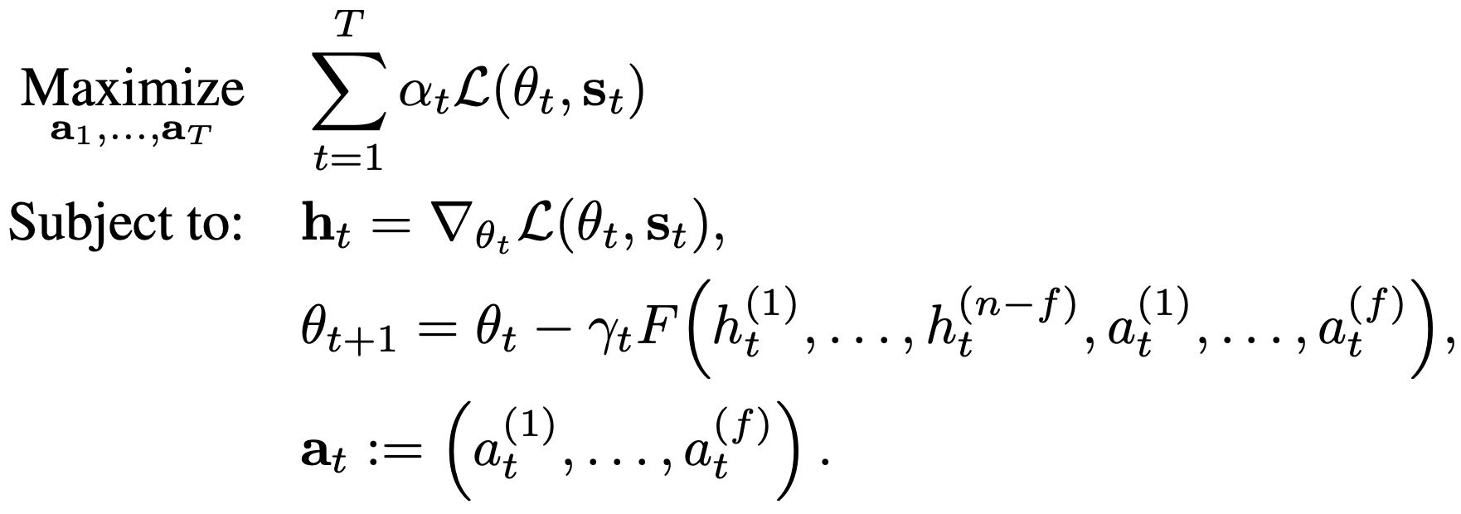
Proposed Solution
- Byzantine attack as a generic optimization problem
- Use Nonlinear Programming (NLP) to solve the Byzantine attack problem
Notes:
We formulate the attack problem as an optimization problem. And then we use nonlinear programming to solve it to seek the optimal attack strategy.
Here we set the objective function as the weighted sum of all losses across the whole training process,
and we use nonlinear programming to optimize on all Byzantine gradients during the whole training process to maximize the objective function.

Slide 12
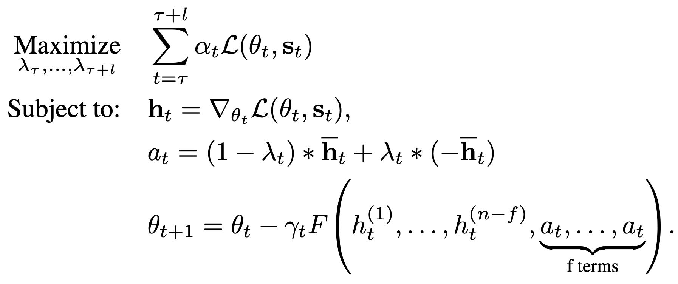
Proposed Solution
- Feasibility in complex tasks: dimensional reduction - use simplified Byzantine gradient format - break the training process to segments of length l
Notes:
However, directly searching all Byzantine gradients of hundreds of iterations to maximize loss will cause very high dimensional and non-convex landscape.
So to make the attack feasible in practice, we used some assumption and dimensional reduction to keep Byzantine gradients in a simple format.
And we further break the training process to segments of length l, and solve each segments one by one to solve the whole problem.

Slide 13
Experiments
Notes:
With the theory and attack design, we can proceed to our experiments.

Slide 14
Experimental Setting
- Simple ==> Complex
2D Mean Estimation
MNIST Logistic Regression
MNIST CNNs
- 6 attacks vs. NLP attack
- on 5 robust aggregation
- 6 attacks vs. Simplified NLP attack
- on 5 robust aggregation
- in homogeneity setting
- with/without distributed momentum
- 6 attacks vs. Simplified NLP attack
- on Krum and CWMed
- in homogeneity setting without momentum
- in heterogeneity setting (Long-Tail Distribution) with D-SHB and NNM
Notes:
The experiments are designed with a progressive roadmap, starting with simple tasks and gradually moving to more complex, real-world scenarios.
The overall goal of these experiments is to explain the practical feasibility and strength of our proposed approach, while also examining its limitations and potential areas for future enhancements.

Slide 15
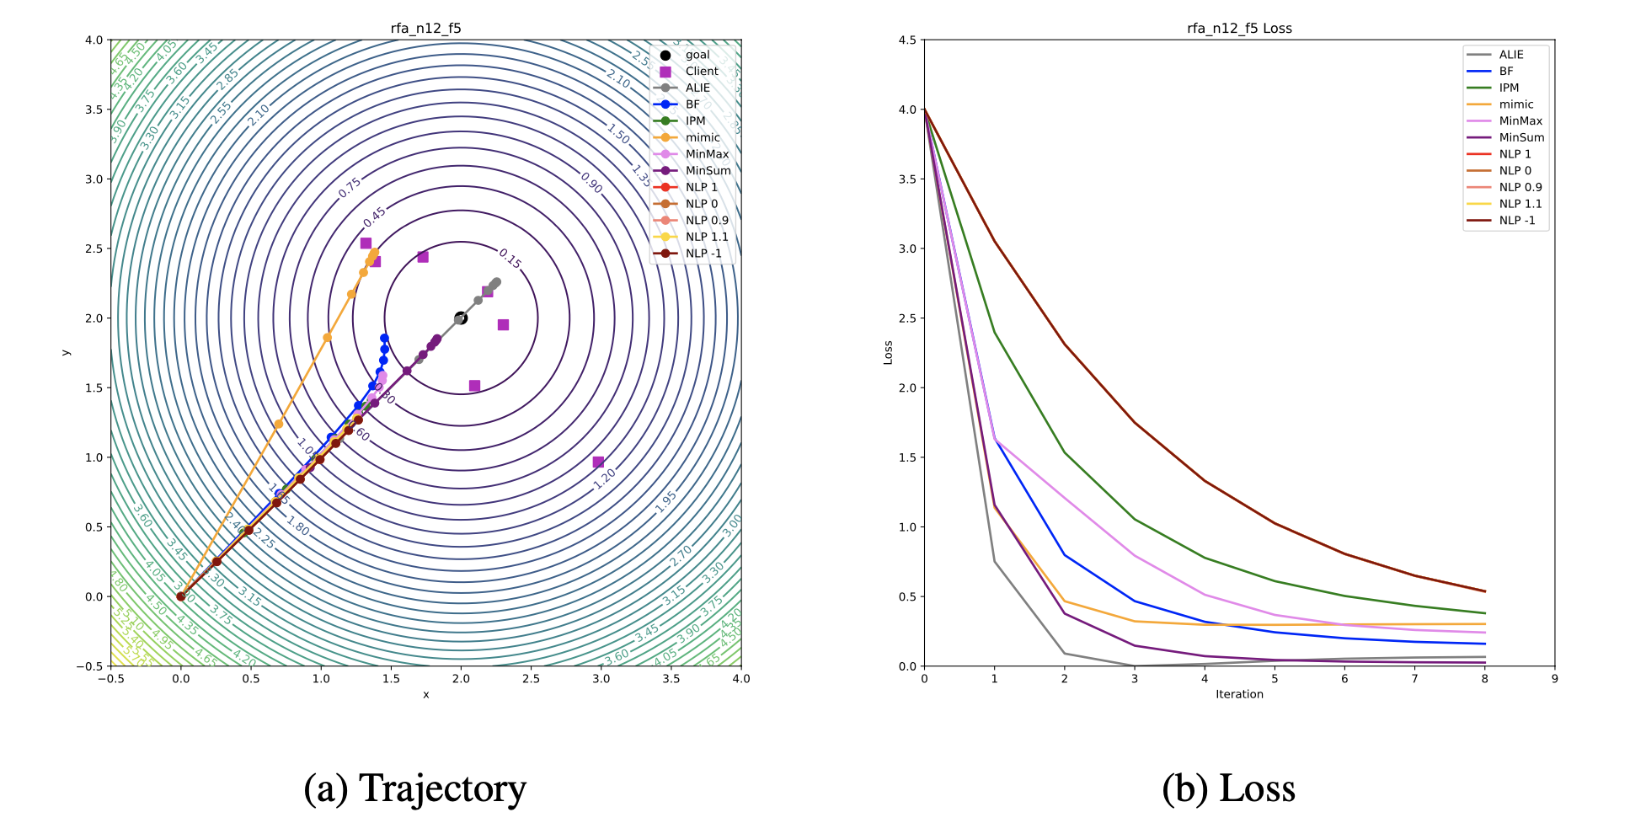
Experiment 1: 2D Mean Estimation Tasks
Geometric Median
Notes:
Moving onto the practical side, we conducted a series of experiments.
The first task involved 2D Mean Estimation, which means we use gradient descent machine learning method to estimate the mean point of several random points.
These are the results of the experiments

Slide 16
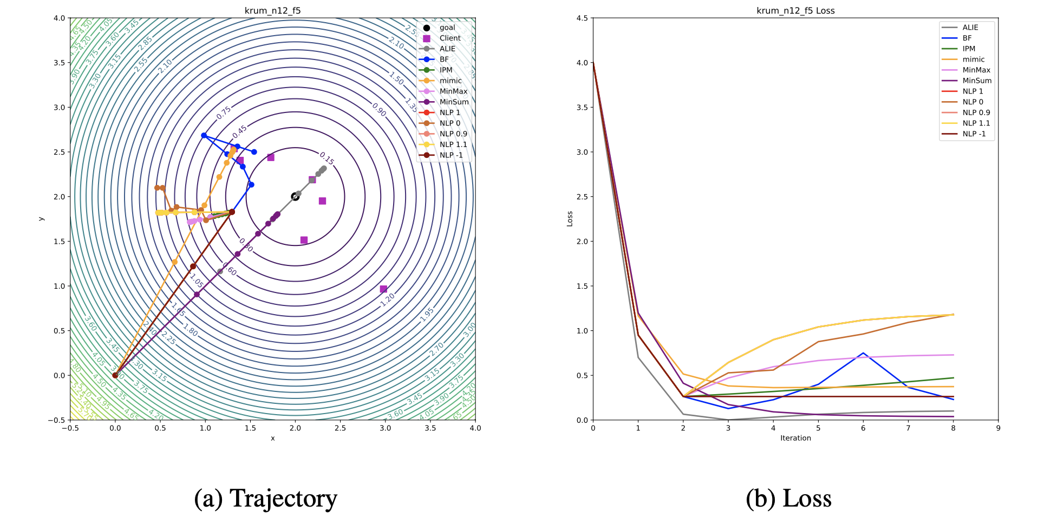
Experiment 1: 2D Mean Estimation Tasks
Krum
Notes:
We can see our Nonlinear-Programming-based (NLP) attacks performed significantly better than others.

Slide 17
Experiment 1: 2D Mean Estimation Tasks
- Full NLP attacks showed best performance
- Objective functions of weighted-mean loss perform best
Notes:
And notably, we tested a set of objective functions including weighted-mean loss, smallest loss and final loss, and weighted-mean loss performs best.

Slide 18
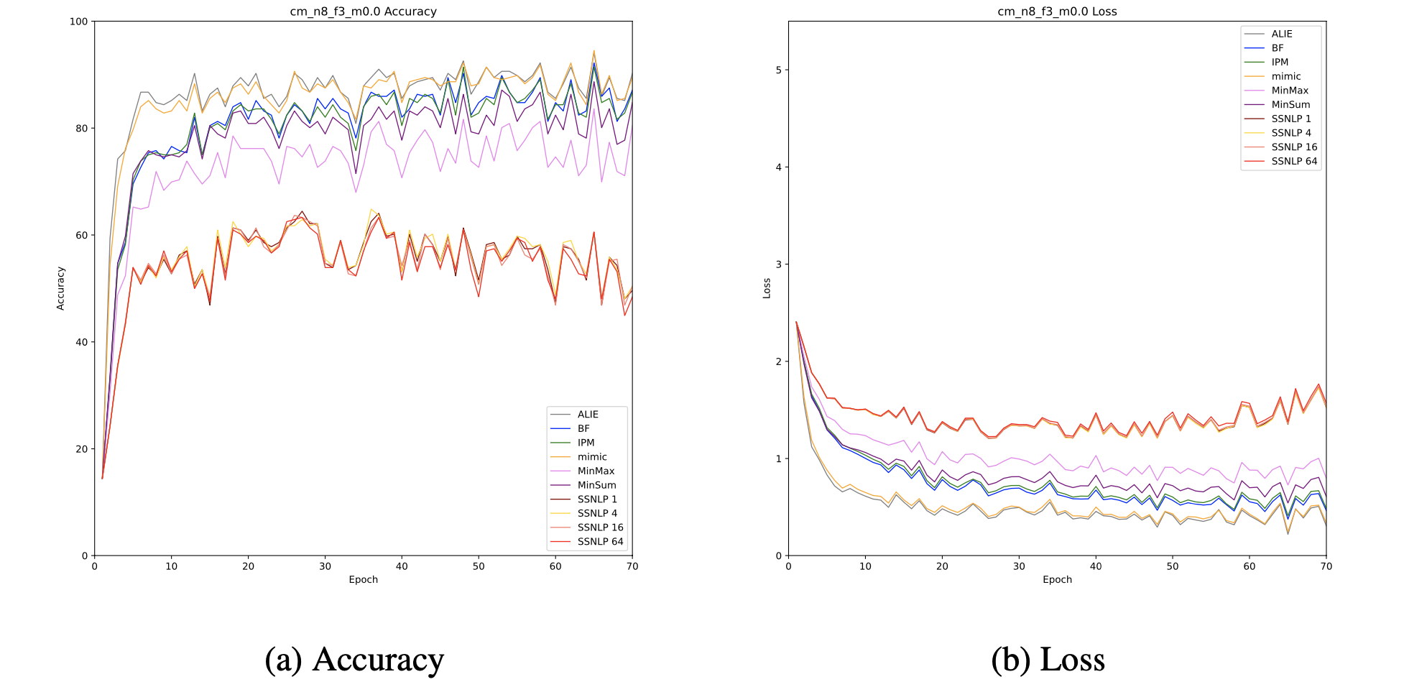
Experiment 2: MNIST Logistic Regression Tasks
Coordinate-wise Median
Without distributed momentum
Notes:
Next, we turned our attention to the MNIST Logistic Regression Tasks.
We vary experiments across whether enable distributed momentum in training, because distributed momentum provides very good defense when dataset is homogenous.
Here again, the NLP attacks outperformed all other contenders.

Slide 19
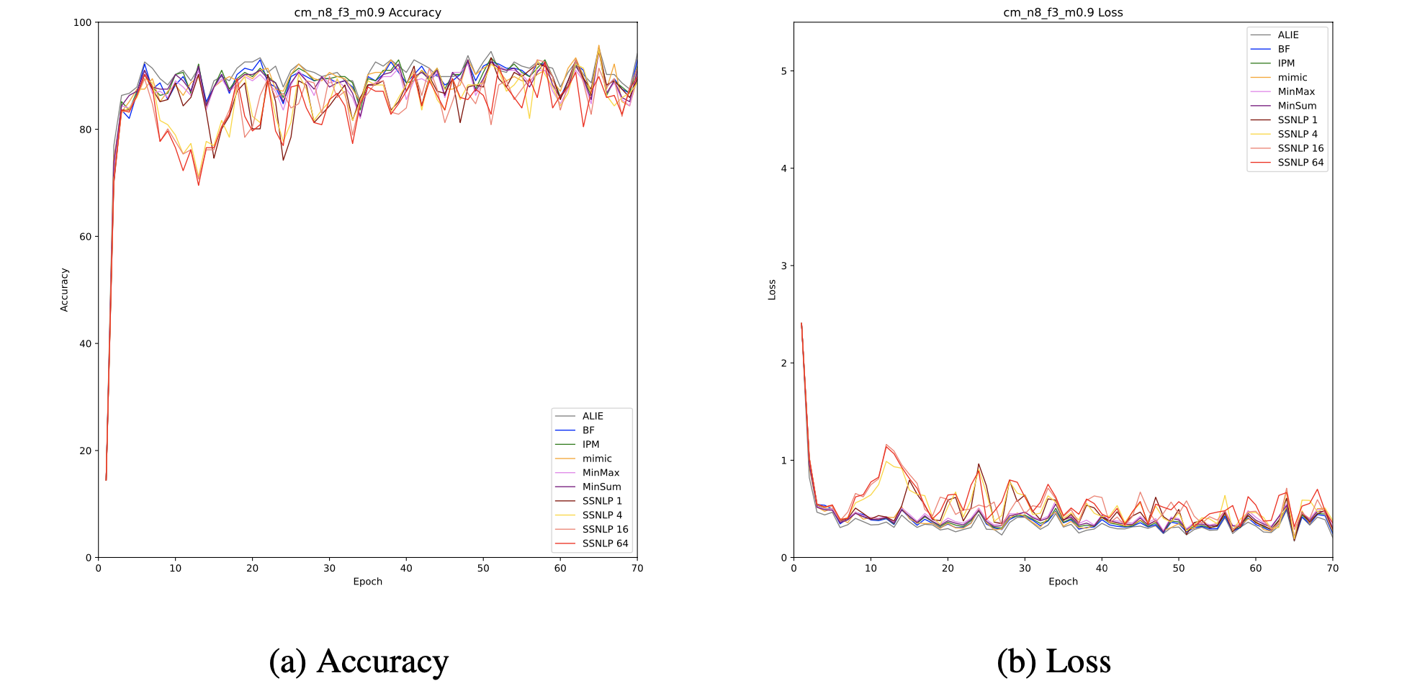
Experiment 2: MNIST Logistic Regression Tasks
Coordinate-wise Median
With distributed momentum
Notes:
And NLP attacks still perform best with distributed momentum, but with a less noticeable advantage.

Slide 20
Experiment 2: MNIST Logistic Regression Tasks
- NLP attacks best performance both with and without distributed momentum
- Less noticeable advantage with distributed momentum
Notes:
So these are our results on MNIST Logistic Regression experiments:
in homogeneity setting, NLP attacks have best performance both with and without distributed momentum.
However, when applying distributed momentum, NLP attacks have less noticeable advantage, but still the best.

Slide 21
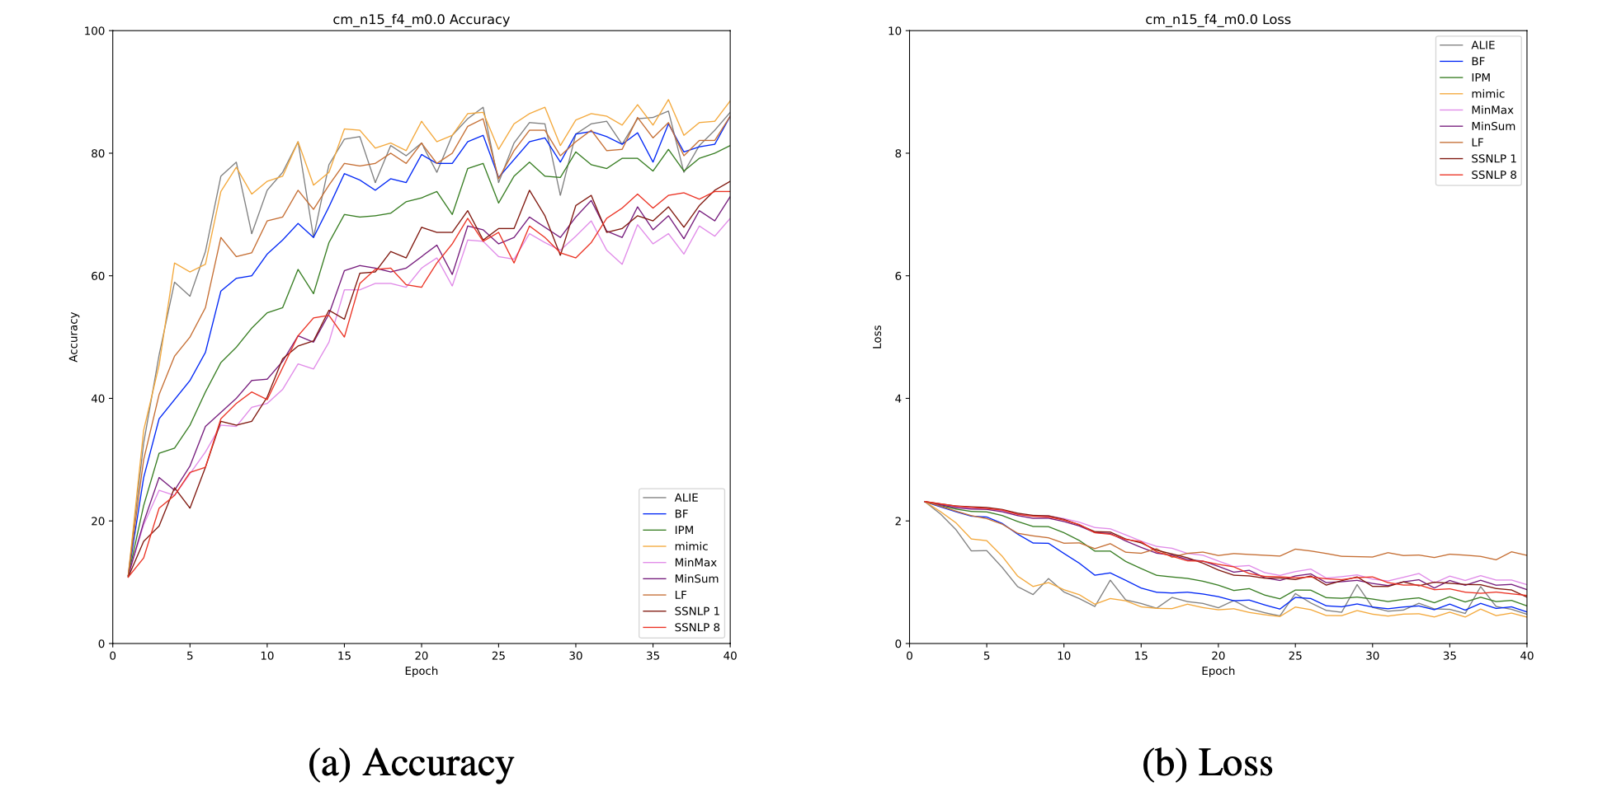
Experiment 3: MNIST CNNs Tasks
Coordinate-wise Median
Homogeneity
Without distributed momentum
Notes:
The final set of tasks involved MNIST CNNs.
The results? Yet again, our NLP attacks held their ground.
They were at their best without momentum in homogeneity setting.

Slide 22
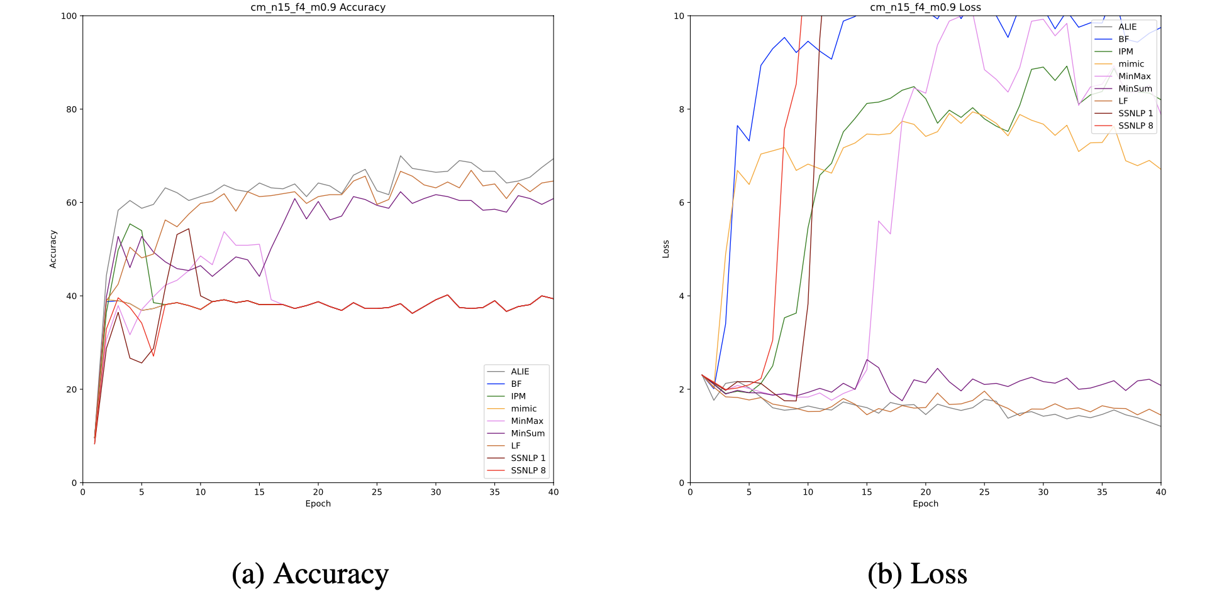
Experiment 3: MNIST CNNs Tasks
Coordinate-wise Median
Heterogeneity
With distributed momentum
Notes:
And NLP attacks achieved much better results in heterogeneity setting, without the application of pre-aggregation methods.

Slide 23
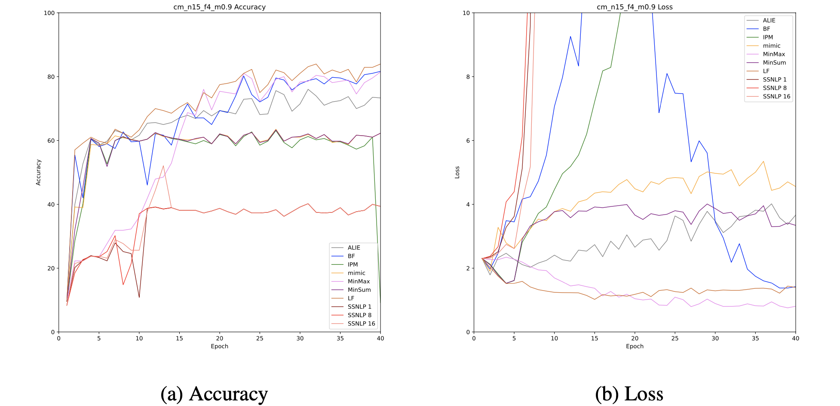
Experiment 3: MNIST CNNs Tasks
Coordinate-wise Median
Heterogeneity
With distributed momentum
and NNM
Notes:
When we applied D-SHB and Mixing in heterogeneity setting, they even trigger gradient explosion when training, and made some model parameters invalid.

Slide 24
Experiment 3: MNIST CNNs Tasks
- NLP attacks strong performance in homogeneous data without momentum
- Superior performance with D-SHB and NNM in heterogeneous data
Notes:
So we can see that NLP attacks have strong performance in homogeneous data without momentum.
And NLP attacks show superior performance when applying D-SHB and Mixing in heterogeneity setting.

Slide 25
Impact on Model Stability
- Mixing process may decrease training stability
- NLP attacks can exploit it to trigger a gradient explosion
- Need for deeper research on this attack primitive
Notes:
In addition, our experimentation led us to an intriguing observation:
the Mixing process can potentially destabilize model training, and NLP attacks can exploit this weakness to trigger a gradient explosion and make the model intrainnable.
This let us think what if we design an Byzantine attack whose goal is to corrupt the training stability, but not directly the accuracy?
This could be a significant avenue for further research.

Slide 26
Conclusion
Notes:
Now based on our comprehensive experiments, we can make a conclusion.

Slide 27
Comparison with Existing Attacks
Our optimal attacks outperform all state-of-the-art attacks
Current attack strategies can be further refined
Existing defense mechanisms may be inadequate against advanced attacks
Efficacy comes with a price: full knowledge and computational overhead
Not applicable in real attacks
But can serve as a benchmark to test the worst case of defense methods
Notes:
Comparing our attacks with existing ones, it was clear that ours outperformed them all.
This means two things:
there's room for significant improvement in the design of current attacks,
and our existing defense mechanisms might not be adequately equipped to handle advanced attacks.
However, best potency comes with a big price: because of the inherent requirement of full knowledge, the attack is never applicable in real attacks. (it’s impossible that an attacker possessing the full knowledge, except that the attacker is the owner of the system)
In addition, even though we use aggressive dimensional reduction, the computational overhead is still large.
However again, though we cannot use it in real attacks (after all we are not attackers), we can still utilize it as a benchmark to test the worst case of existing defense methods.

Slide 28
Conclusion
- First principled approach to designing truly Byzantine attacks
- Existing defense mechanisms may not be fully equipped to thwart advanced attacks
Notes:
In conclusion, we've pioneered a novel approach to designing truly Byzantine attacks.
And our work calls for a reevaluation and enhancement of our existing defense mechanisms.

Slide 29
Future Work
- Use better solvers and customization
- Try different dimensional reduction strategies
- Use reinforcement learning instead of nonlinear programming
- Further research on the stability attack primitive
- Auditing Byzantine Robustness in in Distributed Learning
Notes:
Looking ahead, because in our experiments we selected NLP solvers by some small proof-of-concept experiments, the performance of NLP attacks is restricted by solver performance, so next step we can explore using better solvers and customization in the future.
And in our implementation, we used aggressive dimensional reduction strategies, which might let us lose too much exploitable information and keep us distant from finding the optimal attack strategy. So in the future we can use less dimensional reduction to see what will happen.
And we can try reinforcement learning to substitute nonlinear programming to better approximate optimal attacks.
In addition, we aim to dive deeper into the stability attack primitive we've uncovered. It seems super interesting.
Based on further experiments, we can even conduct works about Auditing Byzantine Robustness in Distributed Learning.
It's a vast field, and we're only scratching the surface."

Slide 30
Questions?
[5] A. Gouissem, K. Abualsaud, E. Yaacoub, T. Khattab and M. Guizani, "Federated Learning Stability Under Byzantine Attacks," 2022 IEEE Wireless Communications and Networking Conference (WCNC), Austin, TX, USA, 2022, pp. 572-577, doi: 10.1109/WCNC51071.2022.9771594.
[5] A. Gouissem, K. Abualsaud, E. Yaacoub, T. Khattab and M. Guizani, "Federated Learning Stability Under Byzantine Attacks," 2022 IEEE Wireless Communications and Networking Conference (WCNC), Austin, TX, USA, 2022, pp. 572-577, doi: 10.1109/WCNC51071.2022.9771594.
[4] Limited vs. Omniscient: How to Choose Your Point of View. Fanbox. 2021
Nonlinear Programming
Notes:
That’s all my content about truly Byzantine attacks today. Thank you for your attention. I'd be more than happy to answer your questions about our work.

Slide 31
Bonus
Notes:
There is still time so I’d like to share some of our observations when exploring training stability in Byzantine machine learning.

Slide 32
STAB - Stability Breaking Attacks
- Old Approach: Decrease model accuracy
- Our Approach: Make the training unstable
- STAB to the heart of Byzantine machine learning (maybe)!
Notes:
Actually, based on our intuition, we designed a stability breaking attack, by maximizing the difference between the largest and smallest values of the model output logits.
(inspired by generating large gradients)
We call it STAB because we thought it may stab to the heart of Byzantine machine learning.

Slide 33
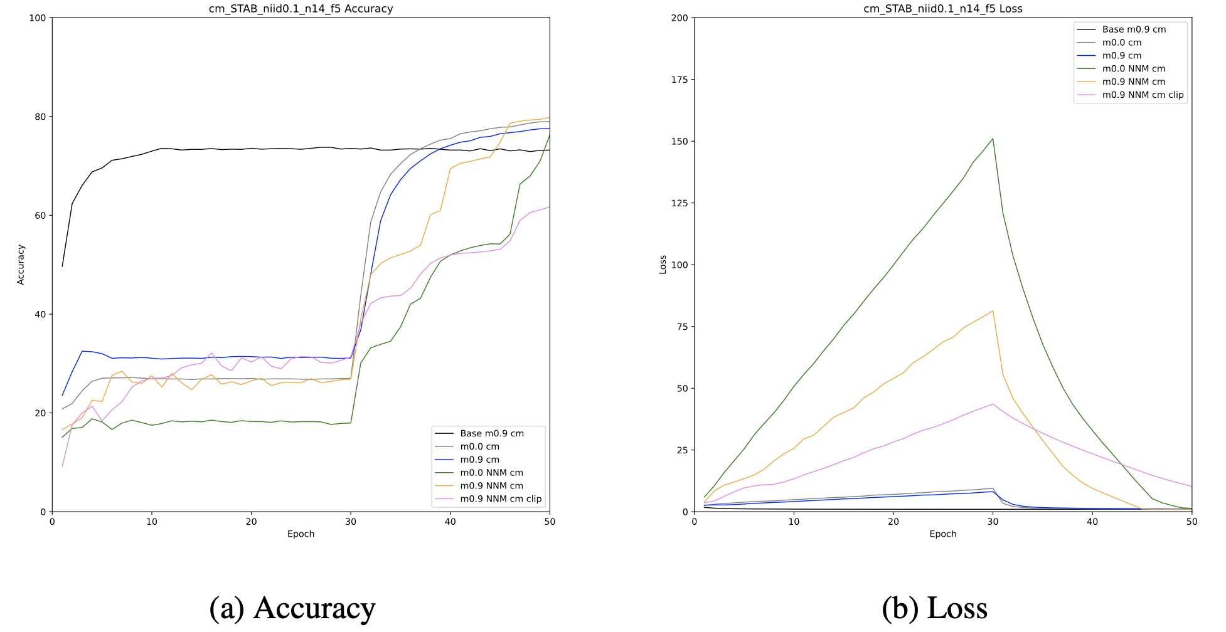
STAB - Stability Breaking Attacks
Notes:
Let's delve into some proof-of-concept experiments we conducted on STAB attack.
We set our stage on the MNIST Logistic Regression task.
Because the Logistic Regression model is fundamentally simpler than more complex networks like CNN.
It has superior inherent stability during training, making our findings highly persuasive.
We carried out our experiments under data heterogeneity, using defensive combinations based on the CM and Krum methods.
And here's what we discovered:

Slide 34
STAB - Stability Breaking Attacks
- Efficacy Across Defenses
- Surprising NNM Interaction
- Limited Protection from Gradient Clipping
- Sensitive to data heterogeneity
Please note: These initial results serve as a springboard for further investigation into the nature and potential of the STAB attack.
Notes:
First, regardless of the defense combination used, the STAB attack proved quite effective.
Second, interestingly, and contrary to what you'd expect, when the NNM defense was included, the attack's potency actually and significantly increased.
This suggests that NNM could potentially undermine training stability.
Third, simple stabilization methods for model training, like gradient clipping, weren't particularly effective in defending against the STAB attack. Even more so, they slowed down the recovery speed of the model once the attack stopped.
Finally, STAB attack is sensitive to data heterogeneity. When we decreased data heterogeneity, the potency of STAB attack also faded.
These are just initial results from our rudimentary experiments. To truly grasp the essence and potential of this attack, much more research is required.

